Slide 1
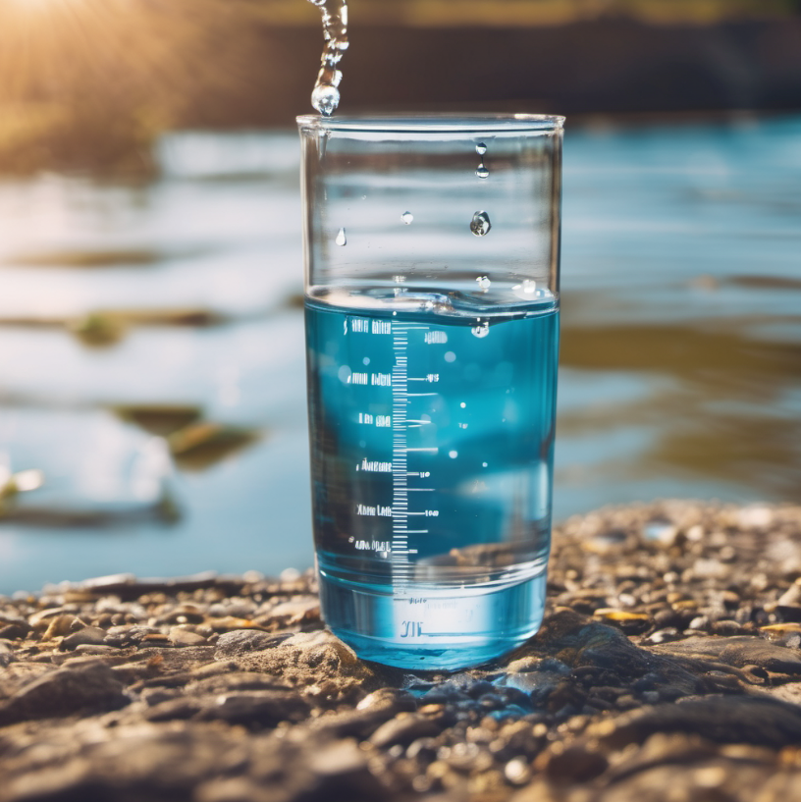
Water Quality Analysis and Prediction
By~
Nirbhay (220412)
Nihar (220381)
Piyush (220491)
Divyanshu (220375)

Slide 2

Problem Statement
Access to clean, safe water is a fundamental human need, yet water quality issues remain a persistent challenge globally. This project aims to address this critical problem by developing advanced analytics and predictive capabilities for water quality monitoring. The problem at hand is to analyze and predict water quality based on various parameters such as Dissolved Oxygen, pH, Biochemical Oxygen Demand (BOD), and Nitrate levels. The goal is to develop a machine learning model that can accurately classify water quality into different categories (e.g., Agriculture Water, Bathing Water, Drinking Water, Polluted Water) using these parameters.

Slide 3

Objectives
Exploring, preprocessing, and visualizing the water quality dataset
Training and evaluating multiple machine learning models (e.g., Logistic Regression, Random Forest, Decision Tree, Support Vector Machines) for water quality classification
3. Visualizing the predicted water quality classes on interactive maps of India, highlighting the spatial distribution of water quality
4. Analyzing the water quality distribution during the COVID-19 period (2019-2021) to identify any potential impacts

Slide 4
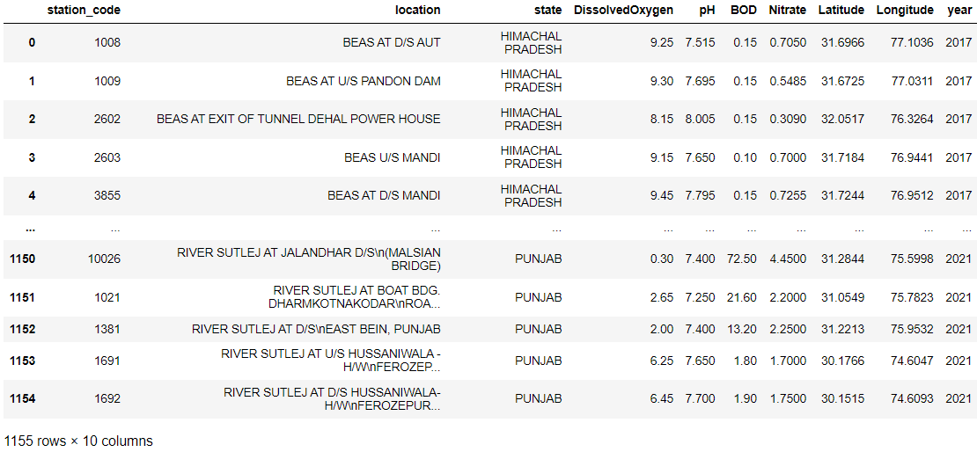
Dataset used:

Slide 5
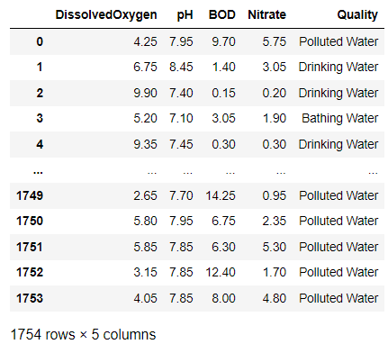
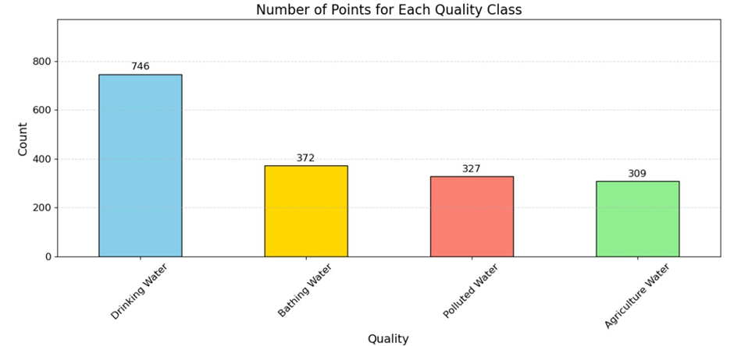

Slide 6
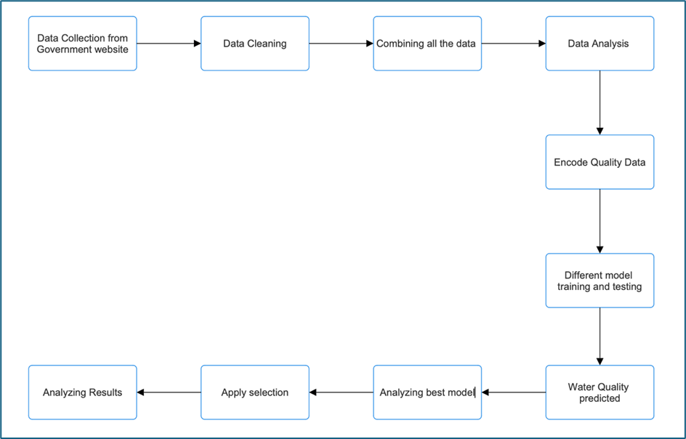
Methodology

Slide 7
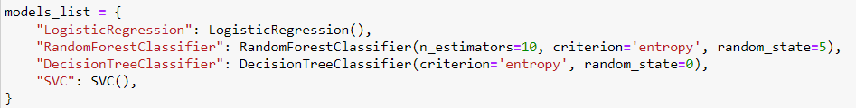
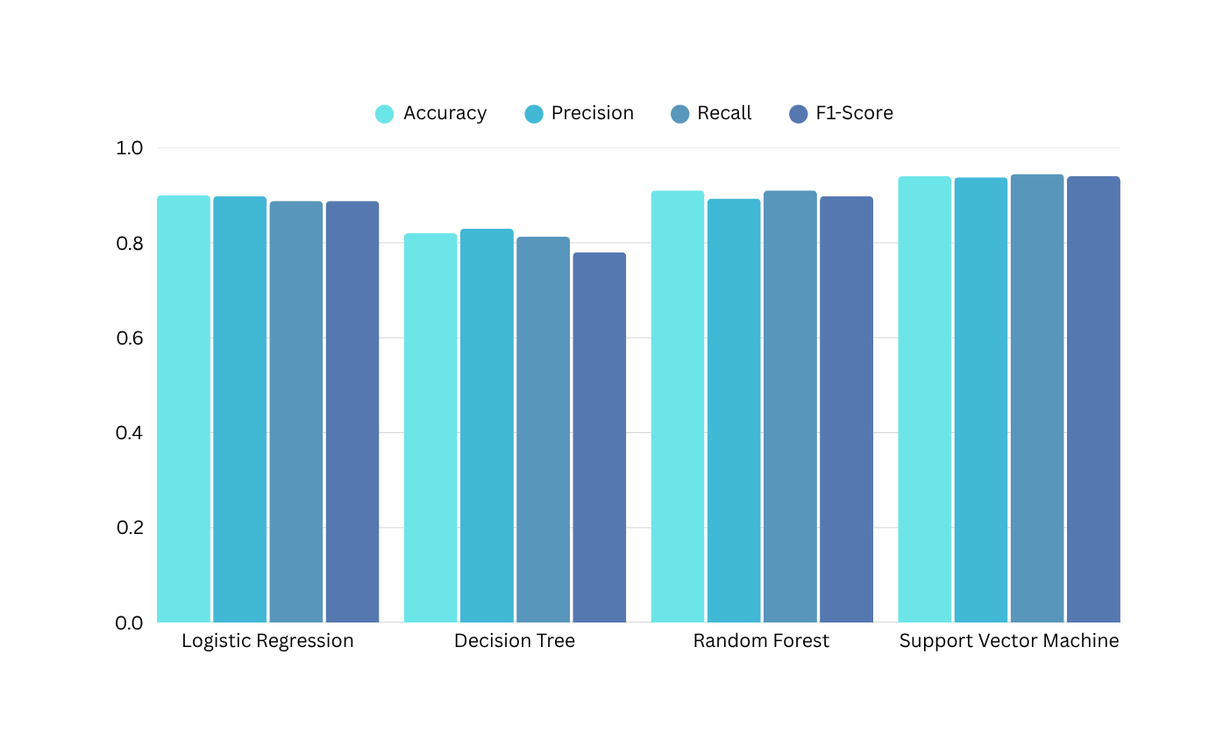
Machine Learning Model Training and Evaluation

Slide 8
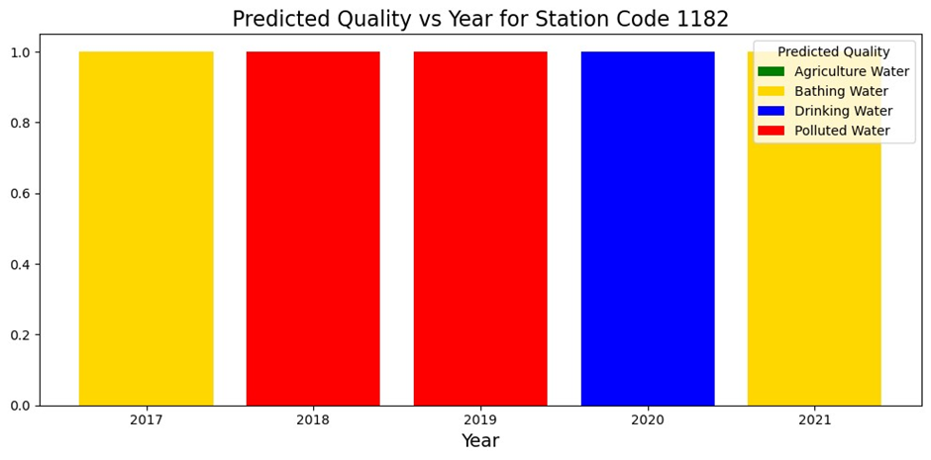
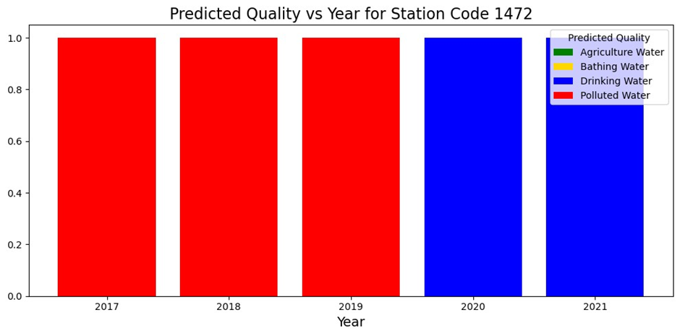
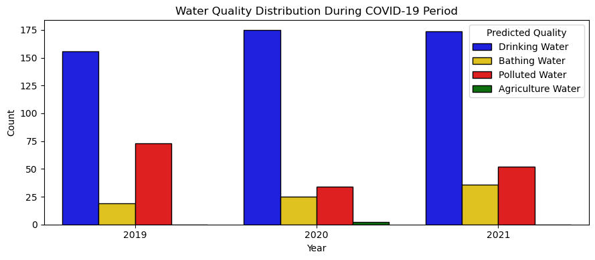
Results and Observations

Slide 9
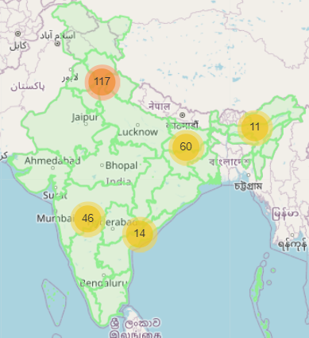
Maps

Slide 10
Conclusion
Our study demonstrates the effectiveness of machine learning, particularly the Support Vector Classifier (SVC), in predicting water quality using physicochemical parameters. Analyzing data from six major Indian rivers (2017-2021), the SVC model achieved an impressive 94% accuracy, outperforming other models. Factors contributing to fluctuations include the COVID-19 pandemic, industrial pollution, and agricultural waste. Continuous monitoring and effective strategies are crucial for sustainable water resource management. Leveraging SVC and machine learning offers valuable insights for informed decision-making by policymakers and environmental agencies.

Slide 11
Future Scope
Additional Parameters: Include more physicochemical parameters like heavy metal concentrations, total dissolved solids, and microbial indicators to enhance predictive capabilities.
Real-time Monitoring: Develop a real-time monitoring system by integrating machine learning with IoT devices for continuous surveillance and timely interventions.
Advanced Techniques: Explore deep learning and ensemble methods to improve prediction accuracy and robustness.
Socioeconomic Impact Analysis: Assess the effects of water quality fluctuations on public health, agriculture, and other sectors for informed policymaking.
Collaborative Research: Foster collaboration and data sharing among researchers and government agencies for developing comprehensive prediction models.

Slide 12



